Slide 1
Workload Characterization in cloud environment
Prepared by
AVITA KATAL
Assistant Professor (SS)
Systemics Cluster
SCS,UPES

Slide 2
Contents
Introduction
Top Level categorization
Cloud Workload Categories

Slide 3
Introduction
In a typical public Cloud, the following actors are involved:
1. Facility managers: They are responsible for the Cloud infrastructure and its operations, i.e., efficient operations of a DC, including the servers, storage, power supplies, and air‑conditioning equipment. Their concern is to run DC with maximum uptime, at the lowest possible operational cost.
2. Cloud IT managers or service providers: They are responsible for scheduling tasks in one or more DCs. Their goal is to maximize utilization of equipment. This may mean maximal loading while leaving sufficient headroom for any usage spikes, monitoring infrastructure performance, planning future capacity growth, and compliance to ensure secure and efficient DC operations
3. Cloud users: They are the customers of Cloud service and may be different than end users, e.g. someone who is renting machines in a Cloud to host an application or provide a service, such that their end users may not know where their jobs are running. Their concern is to provide a QoS that the end user expects at the lowest possible cost.

Slide 4
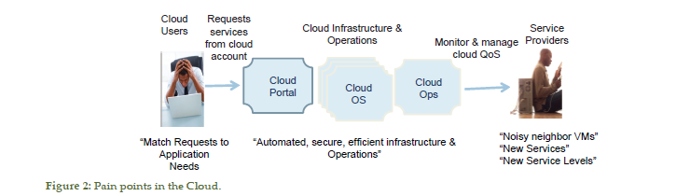
1. Introduction
4. End users: They are the people or businesses on the other end of the Cloud; they may be using mobile or other devices to consume services that are hosted in the Cloud. The end user’s concern is the security of their data and QoS.
5. IT managers: If the Cloud user is a business, they may typically have their own IT manager using internal or enterprise DC, but often going to Cloud for backups, or to deal with occasional workload spikes, or certain type of non‑mission critical business services.

Slide 5
1. Introduction
Figure outlines pain points in the Cloud,
starting with Cloud users who must specify the type of service they will need in advance. If their future requests exceed the parameters of forecast, then the level of service will depend on the elasticity of service providers’ capacity, e.g. since the Cloud hardware is shared between many tenants, it may or may not be fully utilized at a given time.
In the former case, the level of service will deteriorate for all users on a given server, e.g. if one of the users starts to do excessive I/O operations, which will slow down the I/O requests from other users.
This is referred to as a noisy neighbor VM problem such as that caused by placing a streaming media task next to the database accessing job on the same server.
A Cloud user may care only for his or her own QoS, while the IT manager needs to worry about satisfying all the users and the facilities the manager needs to ensure that the hardware is being fully utilized, DC is receiving adequate power and cooling, etc.
There is no silver bullet to solve all Cloud actors’ problems, and an orchestration of actions is needed in response to dynamic monitoring of usage situation at various levels.

Slide 6
2. Top Level Categorization
Workload categories can be split into two top level categorization:
1. Static Architecture
2. Dynamic Behavior
Static architecture
This refers to the implementation of solution architecture such as big data storage or a parallel computational setup.
e.g. is the application distributed in nature using parallel resources or is it serial in nature? Also, what is the size of database that is needed to support this application?
Knowing in advance the type of architecture (parallel or serial) or the size of a database is even more important for layered applications that may be split across different servers, VMs, etc., because an incorrect task assignment will result in poor performance for the application.
In Cloud, it results in a customer asking for a small, medium, or large size of a VM, e.g. 2 GB memory and 1 CPU core for a small VM.

Slide 7
2. Top Level Categorization
Dynamic behavior
This refers to the run‑time nature of resource usage, or stress that a workload places on the computational resources in a Data Center. e.g. how much of CPU time, I/O bandwidth, memory or disk read–write accesses are performed during the application’s run‑time.
In a time‑based access pattern, we are interested in both the peaks and valleys of the usage curves as well as area under the curves.
A small VM that a customer has requested for may be very heavily or lightly used depending on the type of workload that runs within that VM

Slide 8
3. Cloud Workload Categories
The categories in this section include:
Big Streaming Data
Big database calculation
Big database access
Big data storage
Many tiny tasks (ants)
Tightly coupled calculation‑intensive HPC
Separable calculation‑intensive HPC
Highly interactive single‑person tasks
Highly interactive multi‑person jobs
Single compute intensive jobs
Private local tasks
Slow communication
Real‑time local tasks
Real‑time geographically dispersed tasks
Access control.

Slide 9
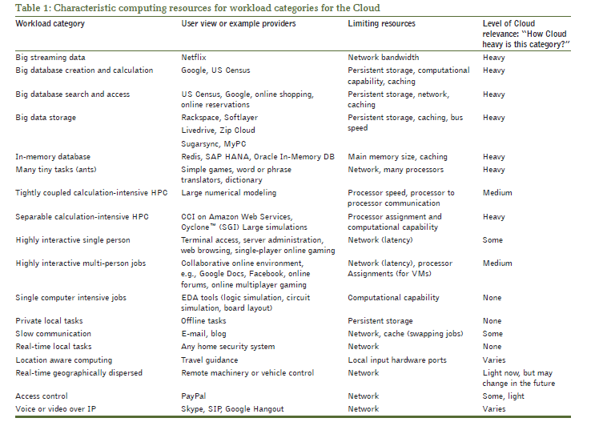
3. Cloud Workload Categories

Slide 10
3. Cloud Workload Categories
Big Streaming Data
The big streaming data workload category is characterized by an interactive initiation followed by long periods of huge amounts of data (usually video) sent to the end customer.
The long periods of transfer may be interactively interrupted and restarted by the end user.
This workload is usually measured by data throughput rather than latency; an example provider in this category is Netflix.
The end user will not complain about, or even notice, a 100 ms delay at the beginning or in response to an interrupt. However, a 100 ms delay between the delivered video frames is very obvious and irritating.
The key underlying hardware resources are the bandwidth to the user, the server delivery, and the network speed from the storage to the server.

Slide 11
3. Cloud Workload Categories
The big database creation and calculation category
This workload is characterized by a large amount of data requiring simple but massive computation efforts (e.g., sorting and analyzing statistics for census data, offline keying for search keys of databases).
Example suppliers are the US Census Bureau, Yahoo, and Google.
The big database search and access workload category
characterized by repeated interactive requests or queries submitted to a very large database.
The customer satisfaction for this category is dependent upon the response time or latency.
The key resources that limit the latency are the database server software and organization, the disk storage, the network bandwidth from the storage to the database server, and the server load.
Examples include Ancestry.com, the Mormon ancestry database, the US Census Bureau, Yahoo search, and Google search.

Slide 12
3. Cloud Workload Categories
The big data storage workload category:
is characterized by the integrity of large amounts of data which is periodically updated, usually by small increments, and that occasionally requires a massive download or update.
The end user sees this as an archiving or data‑backup resource. This workload category in the Cloud is multiuser, as opposed to internal solutions that would have the IT department handle archiving.
Example suppliers in this category are: Rackspace, Softlayer, Livedrive,Zip Cloud, Sugarsync, and MyPC.
The success of this category is primarily availability, integrity, and security of the data. The speed (latency, throughput, storage, incremental processing, and complete restoration) is not the highest priority.

Slide 13
3. Cloud Workload Categories
The in‑memory database workload category
is characterized by the integrity of large amounts of data which is rapidly accessed. The end user sees this as a real‑time database.
The limitation of this category is primarily size of the data. The speed (latency, throughput, storage, incremental processing, and complete restoration) is the highest priority.
An example workload for this category is real‑time business intelligence.
The many tiny tasks (ants) workload category
is characterized by several very small tasks running independently. Small is defined as completely fitting into cache with some room left over for other processes. This might be a lot of cache turtles, not bothering any other process and never being flushed by other processes.
These tasks may or may not have some interactive components. This category depends upon the ability to assign multiple processors.
Each task is independent, so this can scale easily.
Examples of this category are: Small company monthly payroll, document translation, computer language syntax checkers, simple rendering or animation, format conversion, and spelling and English syntax checkers.

Slide 14
3. Cloud Workload Categories
The tightly coupled intensive calculation HPC workload
category is characterized by problems requiring teraflops of computing power.
The base resource is raw compute power and large memory; however, implementing this with multiple processes adds the resource requirements of network speed and software partitioning.
High grid point count matrices of partial differential equations are in this category. The tight coupling of these equations creates a dependency of the solution at each point on the values at many other points.
Classic examples of tightly numerical modeling simulations such as weather‑pattern modeling, nuclear reaction simulation, and computational fluid dynamics.
The separable calculation intensive HPC workload
is characterized by large time‑consuming quantities of calculations.
This workload category is characterized by the ability to split up the calculations to be performed in parallel or small separable pieces.
Examples of separable calculation‑intensive HPC tasks are computer‑aided engineering, molecular modeling, and genome analysis.

Slide 15
3. Cloud Workload Categories
The highly interactive single‑person tasks workload
category is characterized by a fast task with a single user.
The key aspect here is response time latency.
The examples for this category include online single player gaming, online restaurant surveys, and online training courses.
The highly interactive multi‑person jobs workload
category is characterized by the connectivity of jobs.
The resources include the server loading, the bandwidth between servers, and the bandwidth from server to end user.
An example of this category is online multiplayer gaming.

Slide 16
3. Cloud Workload Categories
The single computer intensive jobs workload
category is characterized by high‑speed, large, single‑user tasks that have significant user interaction.
VLSI Integrated Circuit (IC) physical design (including timing analysis, simulation, IC layout, and design rule checking) is an example of this category.
All of the computation for one designer’s part is local, but the database for the overall chip is on the network or Cloud.
The private local tasks workload
category is characterized by traditional single‑user tasks.
Example tasks include word processing, spreadsheets, and data processing.
These might be local for convenience or security. In the case of “thin” clients, these could run in the Cloud. The slow communication workload category is characterized by small amounts of information without a time limit for delivery.
The best example of this is e‑mail

Slide 17
3. Cloud Workload Categories
The real‑time local tasks workload
category is characterized by hardware measurements fed to a computer system.
The resource key here is dedicated CPUs with interrupt‑driven communication to the network.
An example of this is a refinery or factory production monitoring system.
Another example is a home security system.
A third example is health monitoring. The nurses need immediate warning when the patient’s heart monitor beeps. The hospital’s Cloud database needs a continuous storage of each patient’s data over the entire stay.
The location aware workload
category is characterized by utilizing auxiliary location input data (such as GPS or telephone area code) to small amounts of information without a time limit for delivery.
The best example of this is following a route on a map while walking or driving. Another example is using the location information as an additional security check for access while traveling.

Slide 18
3. Cloud Workload Categories
The real‑time geographically dispersed tasks workload
category is characterized by several dispersed hardware measurement systems feeding data to a network.
The resource key here is dispersed dedicated CPUs with measurement and interrupt‑driven communication to the network servers.
The obvious example is weather reporting. The example for this category is power grid management.
The access control workload category
is characterized by user‑initiated requests where the response is to another server authorizing more activity.
The local example is the password on your computer. Most systems rely on passwords and most security experts agree this is a very significant problem . The local example connected to a network (which may be a Cloud) is a bank ATM. The Cloud example is online purchase.
The resources required vary widely with the application and level of security desired. The Cloud is inherently open and flexible.

Slide 19
3. Cloud Workload Categories
A key issue with access control is the conflict with privacy. The various Cloud providers need to verify the identity of individuals and systems using and providing services.
Data for access control include private data. Conglomerations of services (i.e. Cloud provider) must present a trusted environment meeting both security and privacy.
The access control workload category must balance the tradeoff between Cloud provider security and Cloud user privacy.
The voice or video over IP workload category
is characterized by user‑initiated requests where the response is through a server to each other.
This is not presently a Cloud activity.
The resources required are network bandwidth and user local compute power for data compression and decompression.

Slide 20
References
Wira D. Mulia, Naresh Sehgal, Sohum Sohoni, John M. Acken, C. Lucas Stanberry & David J. Fritz (2013)Cloud Workload Characterization, IETE Technical Review, 30:5, 382-397, DOI: 10.4103/0256-4602.123121

